Slide 1
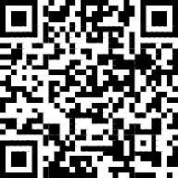
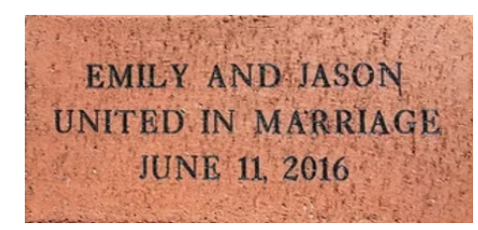
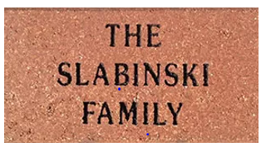
4”x8” Brick: $100 donation
Payable to:
Cardington Community Food Pantry PO Box 168 Cardington, Ohio 43315
Please mail to above address with donation by December 31, 2022. Donations can also be made via PayPal by scanning QR code. Please indicate payment is for Brick Fund Raiser. Return this form to the above address with your engraving information by Dec 31, 2022.
Purchaser Name:
_______________________________________
Phone:
_______________________________________
Email: _______________________________________
Information to be Engraved
3 lines of text allowed ​with 20 characters per line (spaces and punctuation count). Upper and lower case letters allowed. Engraved text will be centered on brick.
PLEASE PRINT CLEARLY:
_ _ _ _ _ _ _ _ _ _ _ _ _ _ _ _ _ _ _ _
_ _ _ _ _ _ _ _ _ _ _ _ _ _ _ _ _ _ _ _
_ _ _ _ _ _ _ _ _ _ _ _ _ _ _ _ _ _ _ _
Cardington Community Food Pantry Board reserves the right to review all engravings and revise as needed prior to placing final brick orders.
Contact: John Lawyer
Cell/text: 419-210-6781
Email: lawyerjp1@yahoo.com
Learn more at Cardingtonfoodpantry.org
Laser Engraved Brick Fund Raiser
The Cardington Community Food Pantry is raising funds to renovate a building for its new permanent location of the food pantry. We plan to create a landscaped front entry way in appreciation of all the community support and donations we’ve received over time. This entry will display laser-engraved bricks that you can personalize. For example you can memorialize or share in honor of a loved one or an organization or you can engrave with your favorite Bible verse. Be creative!
THANK YOU FOR YOUR SUPPORT!
Images shown above are for example only.

